Slide 1

Childcare Costs Regression Analysis
Group 11:
CXN230008 – Chukwunonso Nnodum
PXD230010 – Priyanka Das
SXB220212 – Sampreethi Bokka
BXB240005 – Balu Kiran Bokka
RXC230026 – Riya Chougule

Slide 2

Agenda
Introduction & Background
Literature Review & Contribution
Data
Methods
Results
Conclusion

Slide 3
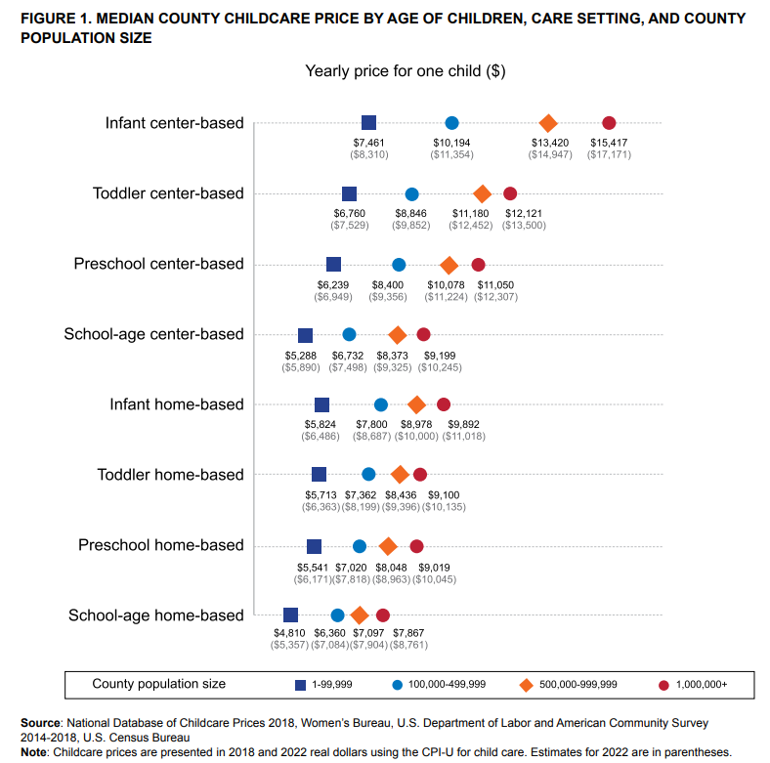
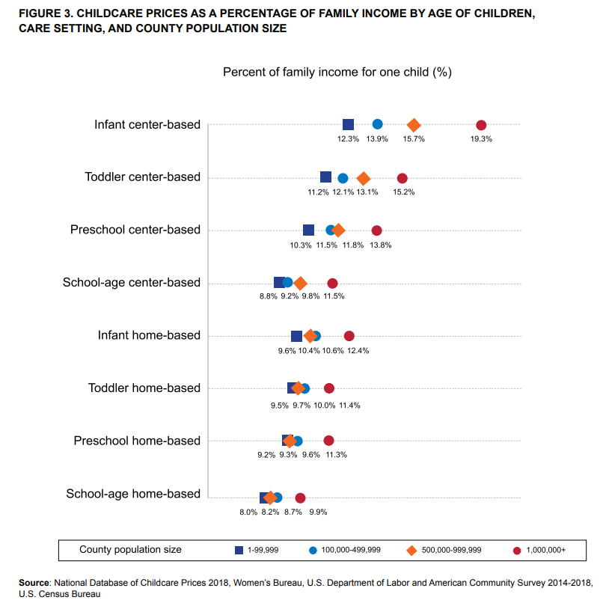
Childcare costs are a significant expense on a household’s income

Slide 4
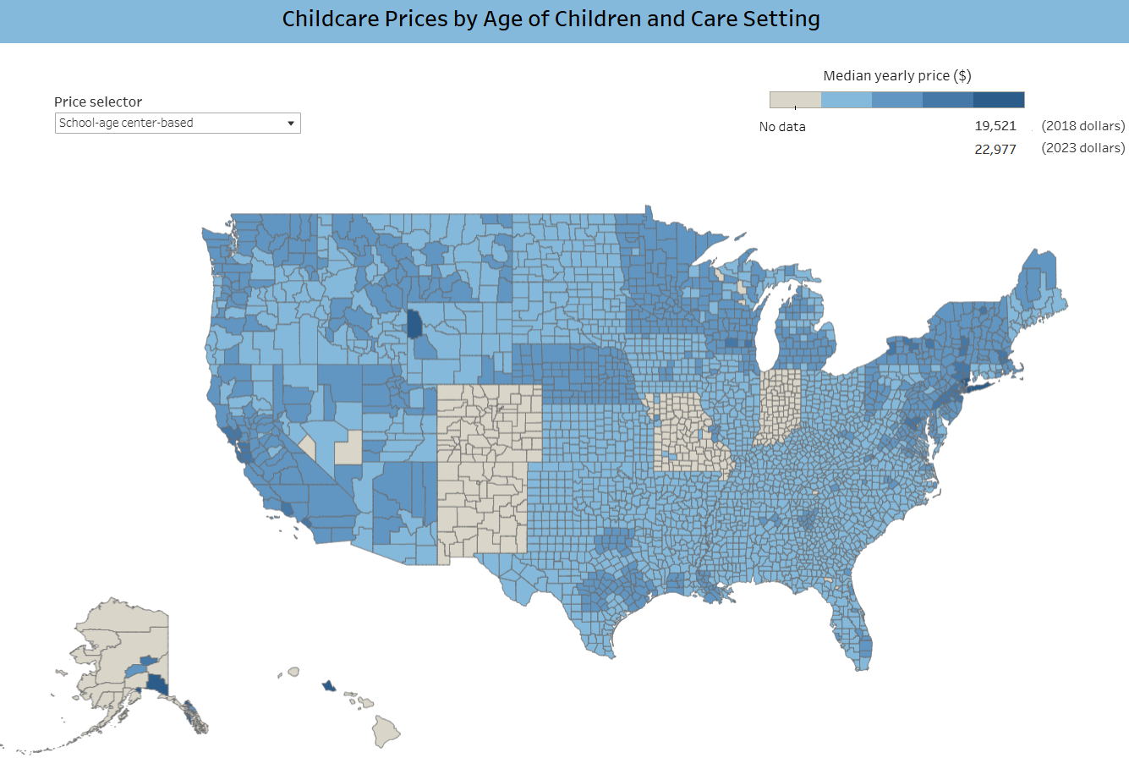
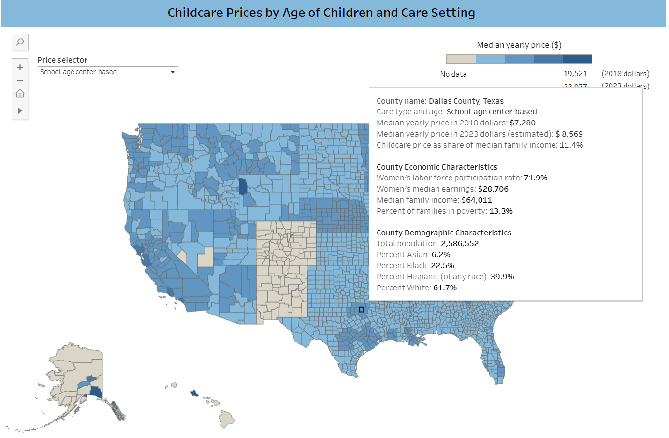
Childcare costs differ by county and state
22,977

Slide 5
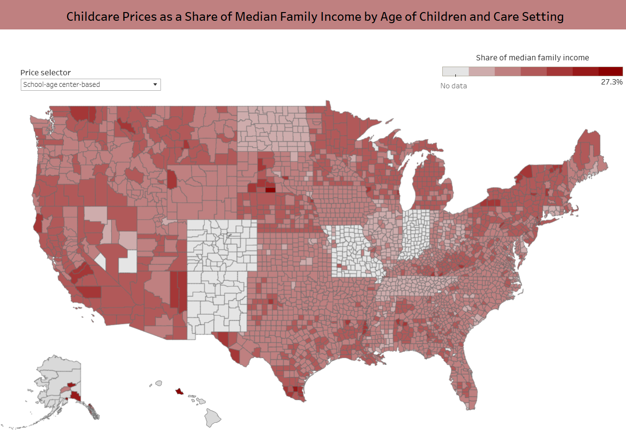
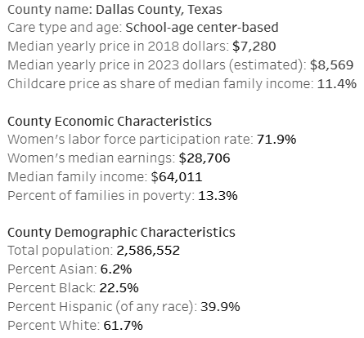
Childcare costs differ by county and state

Slide 6

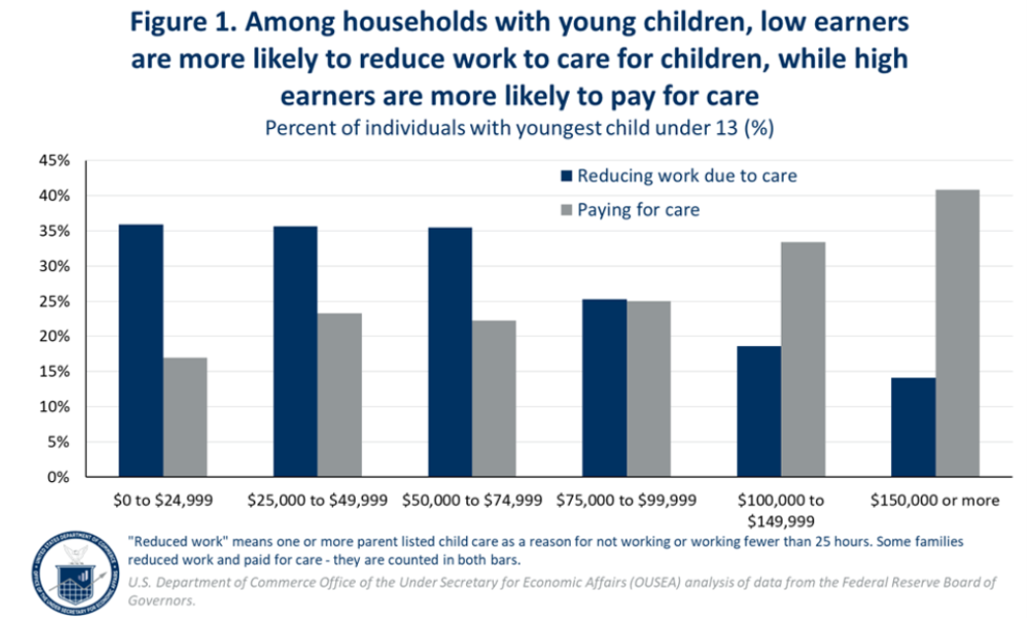
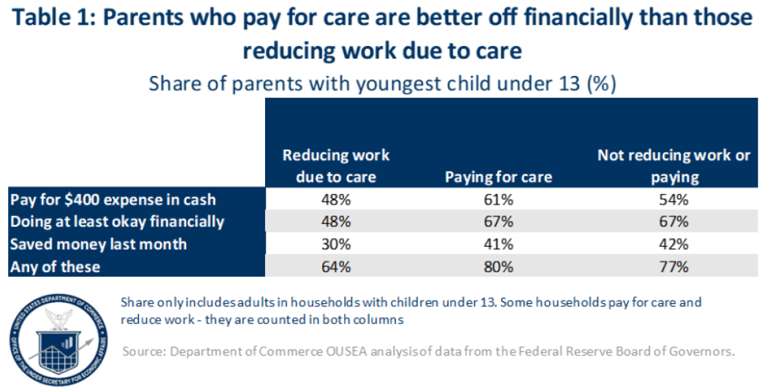
Childcare costs can negatively impact low-income families and workforce participation

Slide 7

Introduction
Literature Review
Contribution
Background
Studies from the U.S. Department of Labor and Pew Research Center highlight rising costs and their strain on families.
Prior work often lacks causal controls or focuses on national trends without controlling for state or county effects.
Our study adds to this literature using panel data and fixed effects to control for geographic and temporal heterogeneity.
Identify the causal impact of median household income and female labor force participation rate (FLFPR) on infant care costs.
Use panel data regression with state and year fixed effects to isolate within-county changes over time.
Provide evidence for targeted childcare subsidy design based on regional demand and income profiles.
Rising childcare costs directly
affect family budgets, women’s
workforce participation, and economic opportunity.
These effects vary widely across
U.S. counties due to income
inequality and labor participation.
Infant care is among the most
expensive center-based services,
making it a critical focus for policy
and research.
Research question: What is the effect of median household income and female labor force participation on center-based infant childcare costs across U.S. counties?

Slide 8

Data
Dataset
Key Variables Used
The data comes from the National Database of Childcare Prices (NDCP) compiled by the U.S. Department of Labor’s Women’s Bureau.
Socioeconomic variables such as median household income and female labor force participation rate (FLFPR) are drawn from the American Community Survey (ACS).
Time span: 2008–2018 across ~3,500 U.S. counties → ~35,000 panel observations.
The panel structure enables use of state and year fixed effects to isolate within-county changes over time.
mc_infant: Monthly cost of center-based infant care
mhi_2018: Median household income (inflation-adjusted to 2018 dollars)
flfpr_20to64: Female labor force participation rate (ages 20–64)
state_name, study_year: Used for fixed effects
Derived: Log-transformed FLFPR, interaction terms, capped outliers
Childcare Costs Database

Slide 9
Dependent Variables
mc_infant:
Other Options:
mfccsa: Weekly, full-time median price charged for Family Childcare for school-age children
mfcc_infant: Family Childcare for infants
mfcc_toddler: Family Childcare for toddlers
mfcc_preschool: Family Childcare for preschoolers
mc_toddler: Center-Based Care for toddlers
mc_preschool: Center-Based Care for preschoolers
mcsa: Center-Based Care for school-age children
Chosen:
mc_infant: Monthly median price charged for full-time center-based infant care in each U.S. countyThis variable is the dependent variable in our panel regression model, reflecting infant care affordability at the county level.

Slide 10
Why Fixed Effects Instead of Naive OLS?
Naive OLS ignores unobserved, time-invariant differences between counties (e.g., baseline demand, local childcare policies).
Fixed Effects (FE) removes bias by controlling for all time-constant county characteristics.
FE ensures that estimated effects of income and FLFPR come only from within-county changes over time, not cross-county differences.

Slide 11

Methods
Data Preparation
Variable Engineering
Statistical Methods
Dropped rows with missing outcome or key predictors (mc_infant, mhi_2018, flfpr_20to64)
Filtered for complete data from 2008 to 2018 (county × year panel)
Applied 1st and 99th percentile caps to treat extreme outliers.
Log-transformed FLFPR to reduce right skew and improve elasticity interpretation
Created dummy variables for state_name and study_year
Generated unique panel ID for each county-year observation.
Used Variance Inflation Factor (VIF) to check for multicollinearity
Estimated Fixed Effects (FE) OLS regression with:
State fixed effects (γ_s)
Year fixed effects (δ_t)
Focused only on center-based infant care costs (mc_infant)
Used robust standard errors (White, 1980) to address heteroskedasticity

Slide 12
Key Empirical Challenges
Endogeneity: Income or FLFPR may be correlated with unobserved factors that also influence childcare costs.
Omitted Variable Bias: Factors like urbanization, provider quality, or state-level subsidies may be missing but relevant.
Simultaneity Bias: Childcare costs can influence FLFPR, and vice versa, creating two-way causality.
These issues may bias OLS or even FE estimates if not properly addressed.

Slide 13
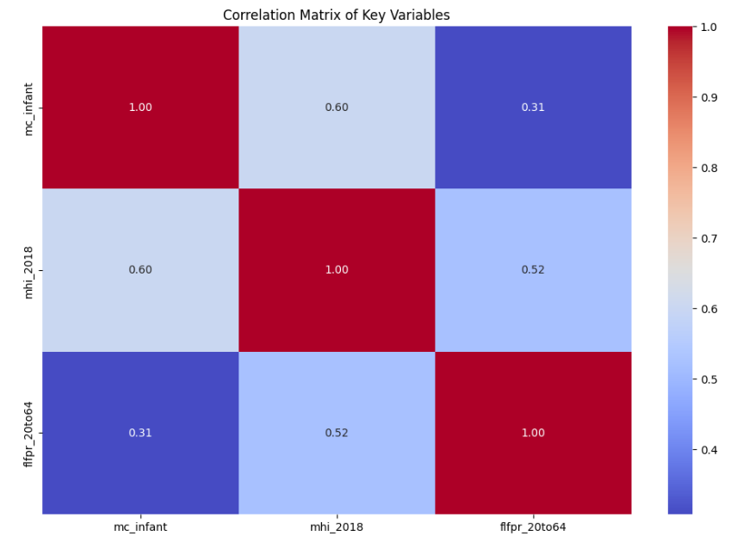
Correlation Matrix Notes: 1. Pairwise correlations between predictors were all moderate to low. 2. mhi_2018 and flfpr_20to64 show moderate correlation (r = 0.52) but no multicollinearity risk was detected (VIF < 3. Both variables were retained due to: (I)Theoretical importance (income & labor participation → demand-side factors) (II)Empirical significance across all model specifications. 4. Diagnostic Step: Checked Variance Inflation Factors (VIF): mhi_2018: 1.37 flfpr_20to64: 1.37

Slide 14
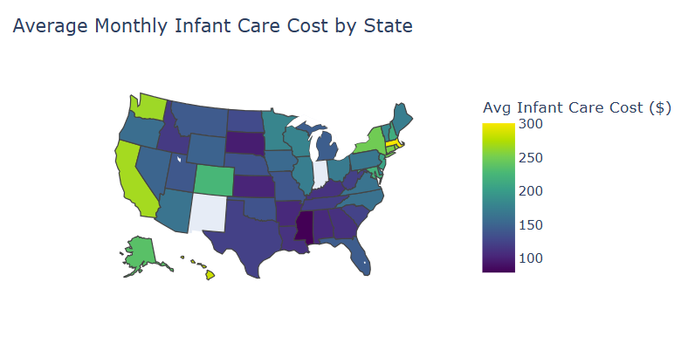
Choropleth of mc_infant by State
R-squared: R²: 0.79
Infant care costs vary widely across states.
Higher costs cluster in urbanized, high-income states like CA, MA, and NY.

Slide 15
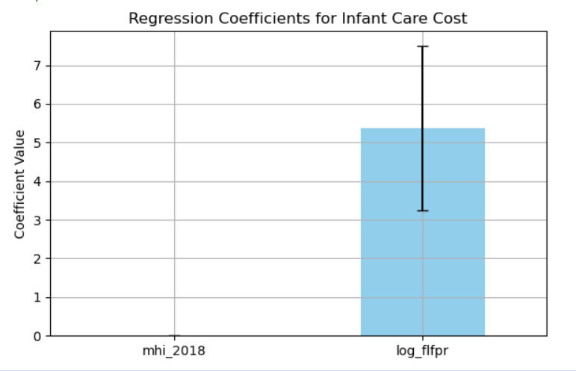
Final Coefficients for mc_infant
Interpretation of Panel Regression (mc_infant):
MHI Coefficient: A $1,000 ↑ in income → ~$1.60 ↑ in infant care cost.
FLFPR (log): A 1% ↑ in participation → significant ↑ in childcare cost.
R² = 0.79 → strong model fit.
FLFPR effect reflects demand-side pressure, especially in working-family regions.

Slide 16
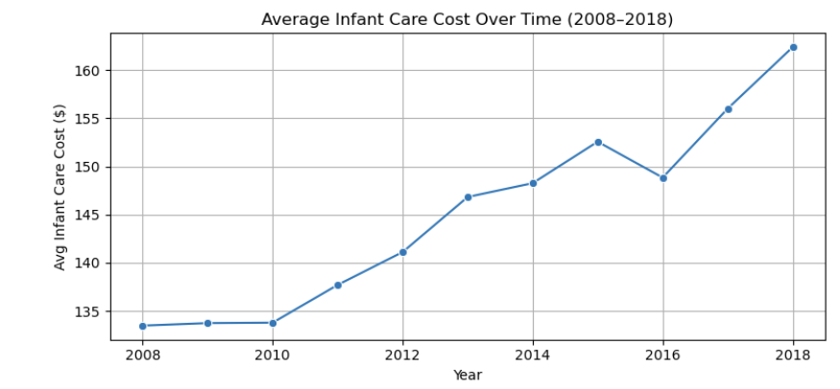
Trend in Infant Care Costs (2008–2018)
Infant care costs have steadily increased from 2008 to 2018 across U.S. counties. This upward trend justifies the inclusion of year fixed effects in the panel regression model, as cost variation over time could confound causal estimates if not controlled for.

Slide 17
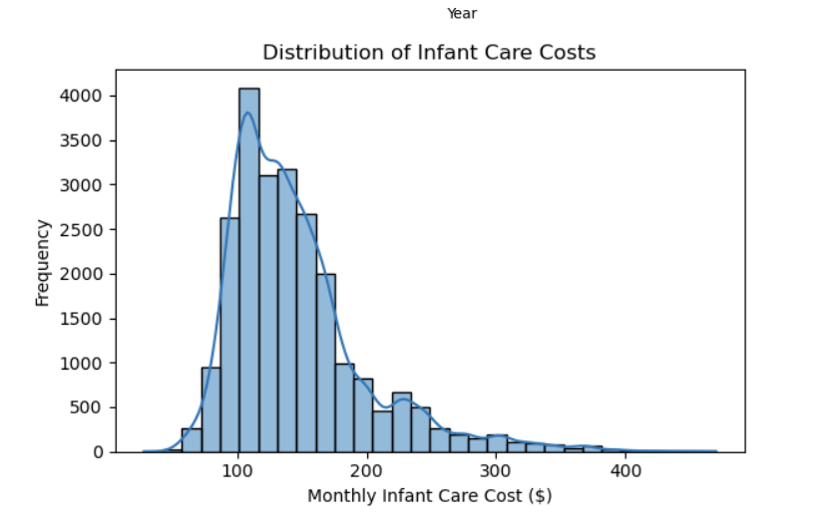
Distribution of Infant Care Costs
The distribution of infant care costs is
moderately right-skewed, with most counties charging between $80 and $120 per month. A few high-cost counties justify the use of outlier capping at the 1st and 99th percentiles to ensure robust regression results.

Slide 18
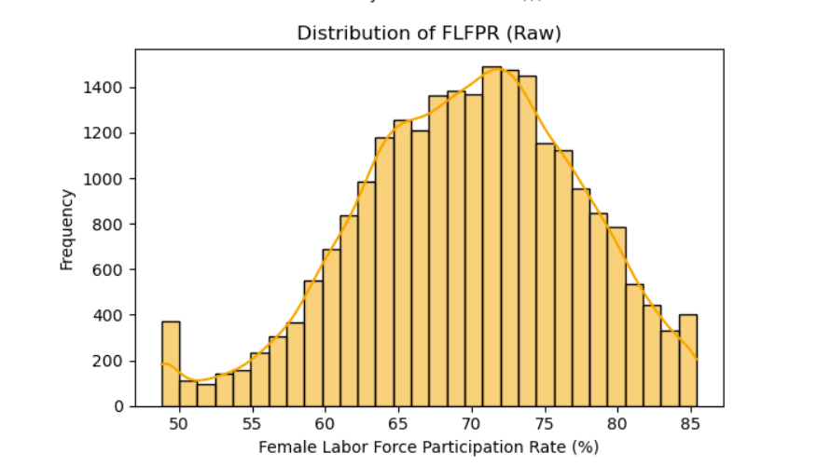
Distribution of FLFPR (Raw Scale)
Female labor force participation rates across counties show a non-normal, right-skewed distribution. This skewness could bias OLS results, prompting the need for a log transformation of the
FLFPR variable.

Slide 19
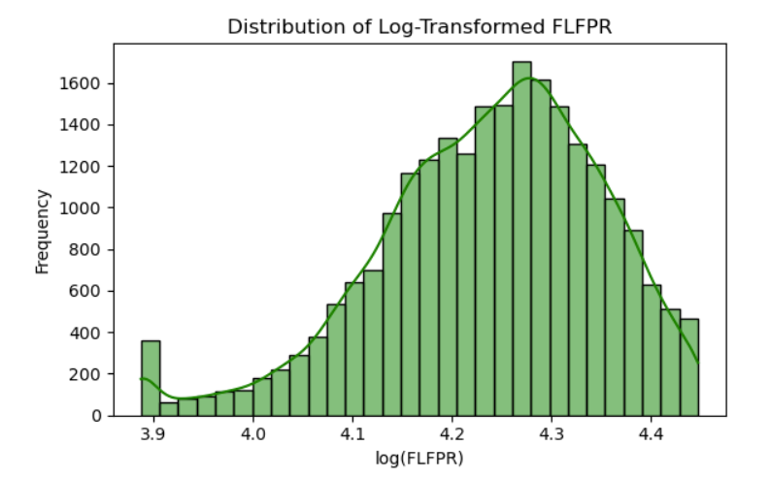
Distribution of Log-Transformed FLFPR
After log transformation, the
FLFPR variable becomes more
normally distributed, improving
model fit and interpretability. The
log scale also aligns with elasticity-based interpretations
of labor force impact on childcare cost.

Slide 20
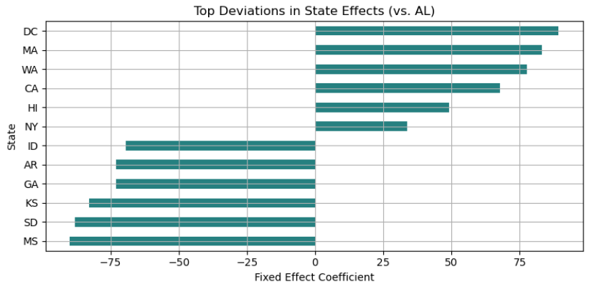
INTERPRETATIONS OF MCSA
This graph highlights how much average infant childcare costs vary by state, even after adjusting for income and labor force participation.
States like DC, MA, and WA show much higher costs than Alabama, while MS and SD are much lower.
This may reflect differences in local policy, cost of living, or supply constraints.

Slide 21
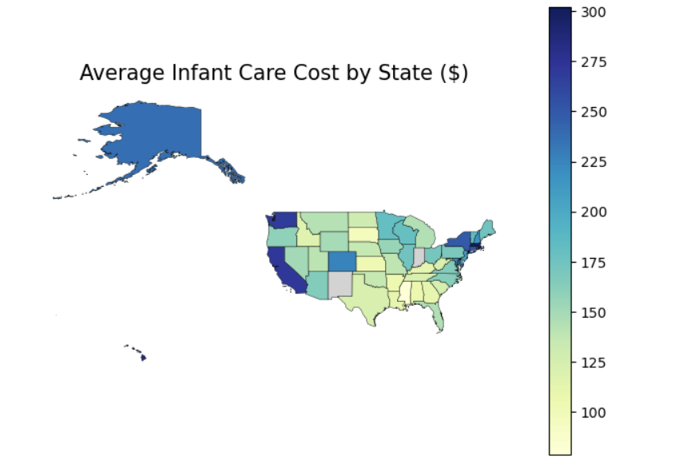
AVERAGE MC_INFANT($) BY STATE
Infant care costs vary widely across states, reflecting local economic conditions and childcare supply.
Urbanized, high-income states like California, Massachusetts, and New York exhibit the highest average costs.
R-squared: 0.790 — Indicates that 79% of the variation in infant care prices is explained by the model.
Suggests that regional factors like cost of living, labor force demand, and childcare regulation play significant roles.

Slide 22
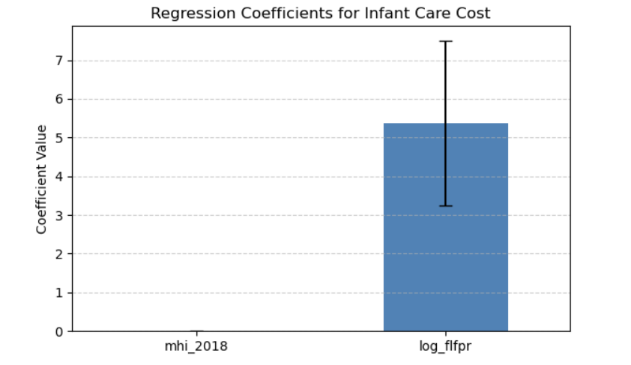
INTERPRETATIONS OF MC_INFANT
Household income (mhi_2018): → A $1,000 increase in median household income is associated with a $1.60 increase in infant care cost. → Reflects cost burden in higher-income, urbanized areas.
Female Labor Force Participation (log_flfpr): → A 1% increase in FLFPR leads to a significant increase in childcare cost. → Suggests rising demand in dual-earner or working-parent households.

Slide 23
What Fixed Effects Doesn’t Solve
FE controls for time-invariant confounders, but it does not solve:
Time-varying omitted variables
Reverse causality or simultaneity
Measurement error in regressors
Remaining concerns motivate robustness checks (e.g., falsification test)
Future work: Consider Instrumental Variables (IV) to improve causal identification.

Slide 24
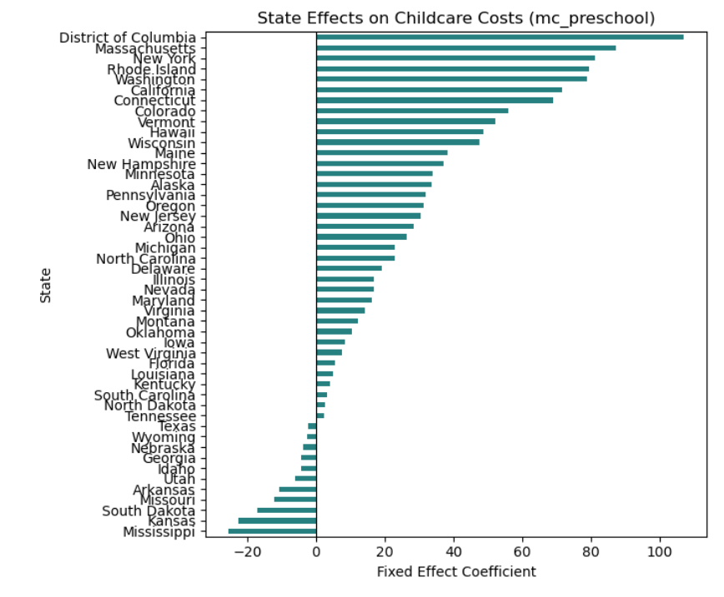
INTERPRETATIONS OF MC_PRESCHOOL (State Fixed Effects)
High-Cost States:
Washington (+1.53), Massachusetts (+1.21), Maryland (+1.08), Connecticut (+1.03) have the highest childcare costs relative to Alabama, likely due to higher income, demand, or stricter regulations.
Low-Cost States:
Mississippi (–0.90), South Dakota (–0.84), and Tennessee (–0.56) show significantly lower childcare costs, indicating affordability in rural or low-cost areas.
Moderate States:
States like New York (0.59) and California (0.53) are moderately more expensive than the baseline.
Near-Baseline:
Delaware (0.02) and West Virginia (–0.01) are close to average, with minimal deviation from Alabama.

Slide 25
Falsification Test for mhi_2018 (Income)
Objective: Test whether mhi_2018 is spuriously correlated with unrelated outcomes
Approach: Regressed mhi_2018 on 5 placebo dependent variables
Results:
No significant effect on: 1. mlfpr_20to64 (Male Labor Force Participation) 2.emp_p (Employment in Public Admin) 3.h_6to17_single_m (Single-Mother Households, Age 6–17)
Significant effect found on: 1.emp_sales (p = 0.0456, negative) 2.households (p = 0.0039, positive)
Interpretation:
Majority of tests support exogeneity
Some mild concerns about confounding
Suggests robustness checks or IV may be useful

Slide 26
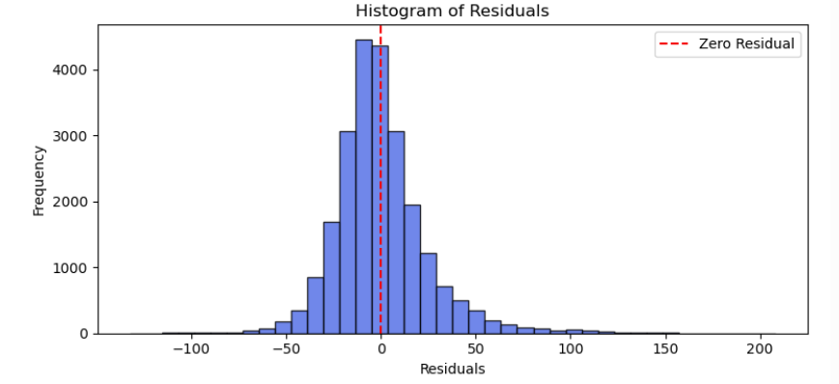
Residuals
The residuals from the mc_infant regression are approximately normally distributed, centered around zero.
While not perfectly normal, the shape is symmetric and bell-shaped, suggesting MLR.6 (normality of errors) is reasonably satisfied.
This supports the validity of t-tests and confidence intervals in our regression analysis.

Slide 27

Conclusion
Regression Analysis
Opportunities for future analysis
Application
Income and Female Labor Force Participation (FLFPR) are strong predictors of higher center-based childcare costs, especially for infants.
States like WA, MA, and CA have significantly higher costs even after controlling for income and FLFPR, suggesting structural/policy-driven differences.
Extend analysis to family-based care and different age groups (toddlers, preschool).
Explore additional factors like provider density, urbanization, or state subsidy programs.
Evidence supports targeted childcare subsidies in high-cost, high-participation areas.
Results can guide policy discussions around equity in access and affordability of early childhood care.

Slide 28

Thank you!
Resources
https://www.dol.gov/sites/dolgov/files/WB/NDCP/508_WB_IssueBrief-NDCP-20230213.pdf
https://www.dol.gov/agencies/wb/topics/featured-childcare
https://www.commerce.gov/news/blog/2024/06/childcare-costs-reduced-work-and-financial-strain-new-estimates-low-income

Slide 29
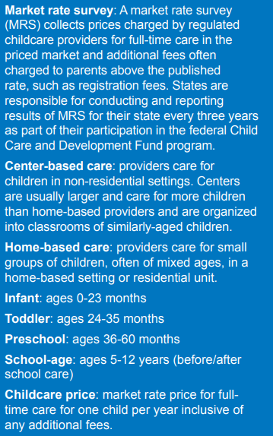
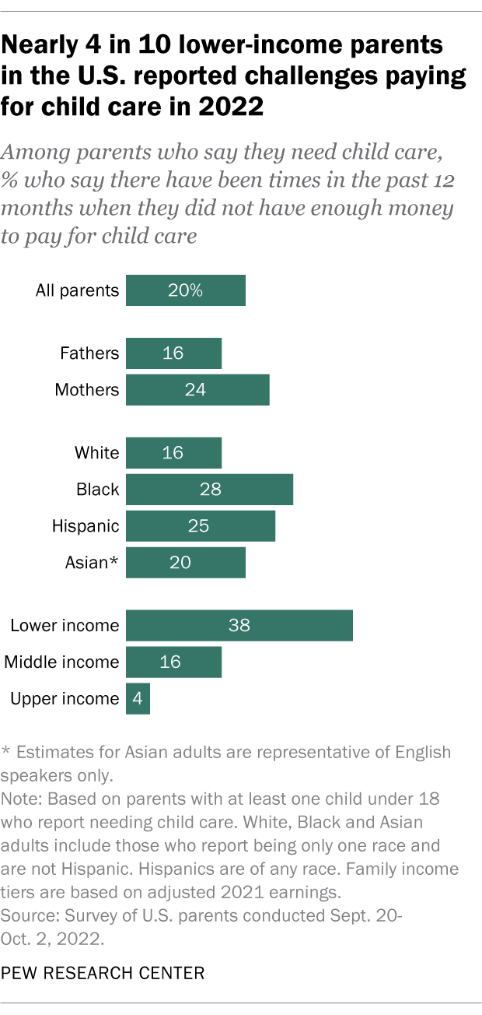
Appendix

Slide 30
VARIANCE INFLATION FACTOR
Multicollinearity Check:
Most VIF values are within acceptable limits (VIF < 5).
mhi_2018 and pr_f exceed 5, suggesting some multicollinearity, but are retained due to strong theoretical justification.
No variables were dropped based solely on VIF.
We conclude multicollinearity is not a major issue in the final model.

